Slide 1

Automated Car Wash
PLC Controlled Vehicle Cleansing
46978518

Slide 2
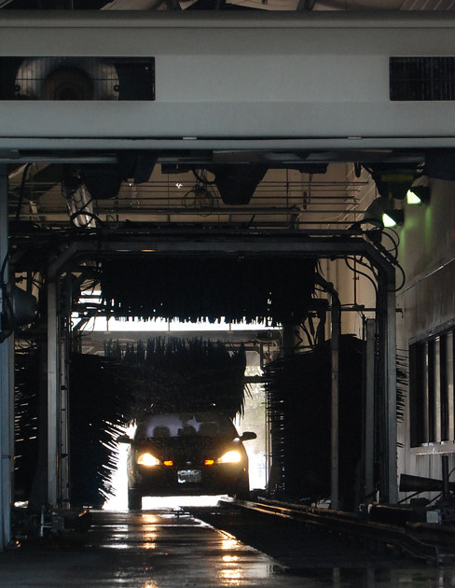
Self Serve to Automatic
Customers used to have to manually wash their vehicle with equipment provided
Automatic systems use a combination of sensors, motors, brushes and jets to clean the vehicle
Automatic cleaners reduce waste while ensuring the car is properly cleaned
Rollover, Conveyor, and touchless car wash systems are quickly becoming more popular than manual wash systems.
This Photo by Unknown Author is licensed under CC BY
Notes:
Self serve manual systems required users to park their car in the bay and use the washing and scrubbing tools provided to clean the car by hand. \
Typically these would charge per minute rates for soap and water.
Waste a lot of water as wash is manual, slow and not thorough
Automatic car washes use less water, less detergent
washes cars thoroughly through PLC Controls
First car wash was in Detroit 1914, called a automated laundry. Run by workers paid to wash cars.

Slide 3
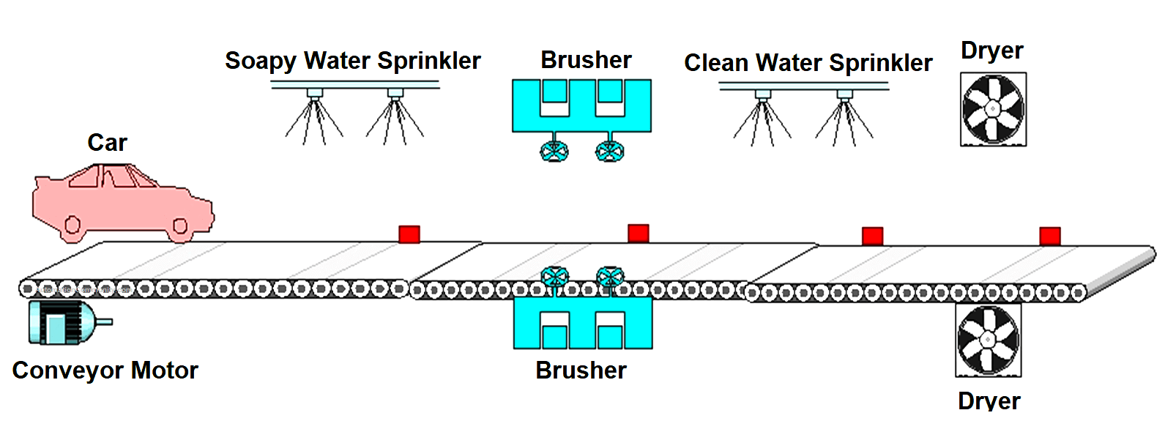
Operating Principle
1.Car Entry and Elevation: The car is driven onto a conveyor and into the bay. It is then lifted using either a conventional lift mechanism or modern pressure cylinders, allowing washing and sprinkling devices to reach it.
2.Detergent Application: Solenoid valves are programmed to open at specific intervals. They release detergent water at the optimal pressure to wash away dirt and grime.
3.Brushing and Sprinkling: Brushes are used to clean the car while the sprinkler system washes it through solenoids and nozzles. This ensures a thorough cleanse.
4.Drying: After the washing cycles are completed, air dryers are used to remove moisture from the car, preparing it for delivery.
Notes:
There are many different configurations of car wash. Including those configured for large vehicles, such as vans trucks and semi-trailers.
The 4 main steps behind contact-based car washes
Apply Soap
Brush
Rinse
Dry
Red squares are IR sensors used to position the car
In this example a conveyor is used, however in rollover systems the car is stationary, and the equipment is moved on gantries

Slide 4
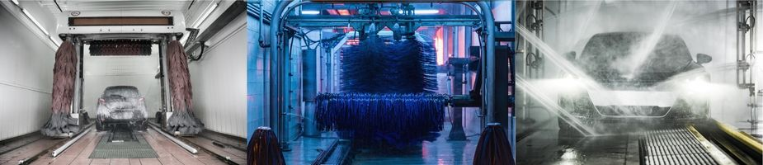
Types of Car Wash
Roll Over | Conveyor | Touchless
Vehicle is driven into a bay. Washing equipment is moved about the car on gantries/linear rails. | Vehicle is driven onto a conveyor belt, which moves the car through the cleaning equipment. Faster cleaning times. | Relies on powerful jets of water and detergent to wash away dirt. Inconsistent results, most development is in this technology.
Notes:
Roll over car washes use motors, gantries and sensors to move the equipment around the car
Can damage if sensing is done improperly or equipment hits side mirror
Conveyor moves the car through the different steps of the process,
Both rollover and conveyor can potentially chip or damage the car with contact cleaning methods
Touchless cleaners just use jets of water and soap to clean
Currently less effective, will be implemented into tunnel cleaners in future with development.

Slide 5
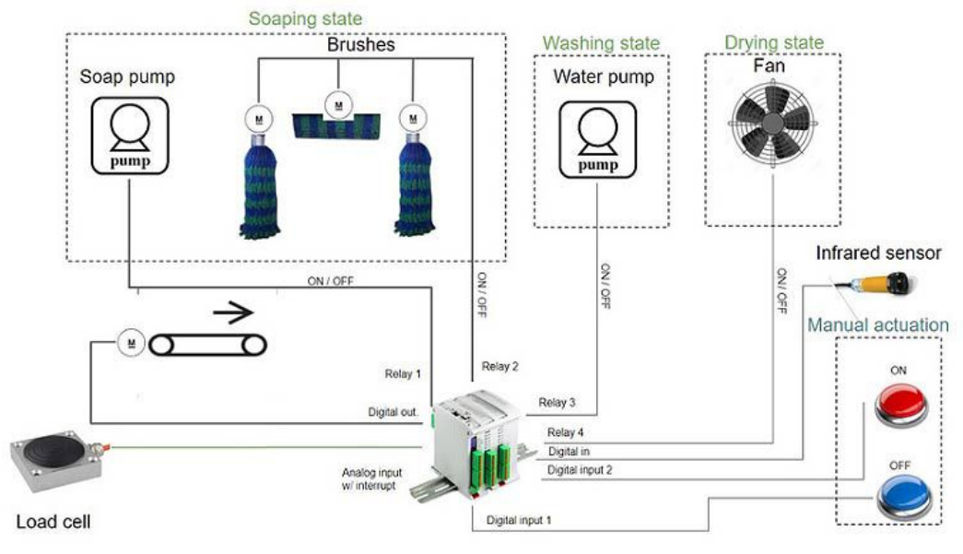
Components of Roll-Over and Conveyor Washes
Motors and limit switches control speed and position
IR Sensors used to detect the position of the vehicle
Conveyor Washes use a conveyor belt to position the car
Pumps are needed to apply water and soap through jets at specific intervals
High power fans are needed to dry the vehicle at the end
Customer Controls for payment and activation
Some car washes use a load cell to detect vehicles

Slide 6
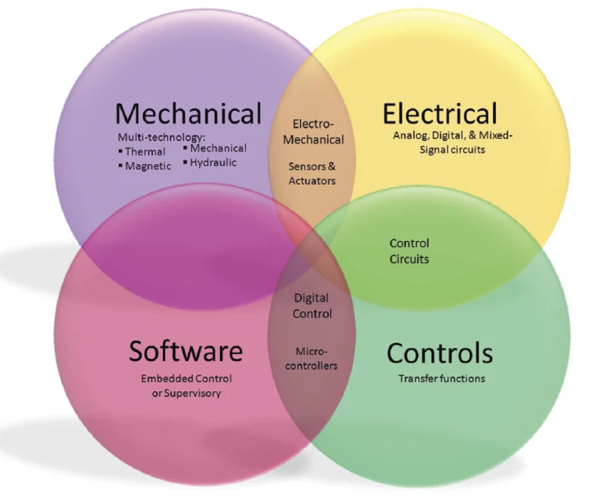
What makes it a Mechatronic System?
Actuators:
Motors are used for positioning and driving brushes
Solenoid Valves are used to control the flow of water
Sensors:
IR sensor are used to detect the position of the car
Accurate position of gantry for brushes
Control:
Accurate control is needed to efficiency and safety of the system.
PLCs are commonly used in controlling Car Washes. Examples Include:
OMRON SYSMAC CPM
M-Duino 19R
Mitsubishi
Notes:
Actuators
Motors
Valves
Pumps
Sensors
IR Sensors
Limit switches
Motor Encoders
Control
PLC system is most popular modern method of control
Most effective in a prolonged deployment
Reduces debugging time and maintenace.

Slide 7
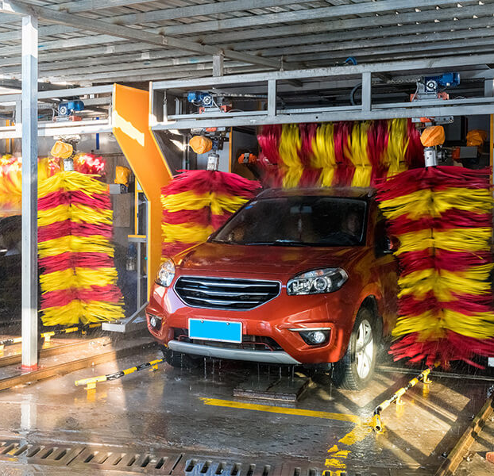
Needs and Usefulness
Automatic car washes have several benefits:
More effective than hand washing
Uses less water
Minimises use of chemicals
Time efficient
No equipment or knowledge required
Systems are available that cater to semi-trailers, buses and large vehicles.
Notes:
Car washes are faster and more effective than washing by hand, and can recycle water to be even more efficient.
Useful for people who are unable to clean their own car, elderly, disabled
Also useful for cars too dirty to clean by hand

Slide 8
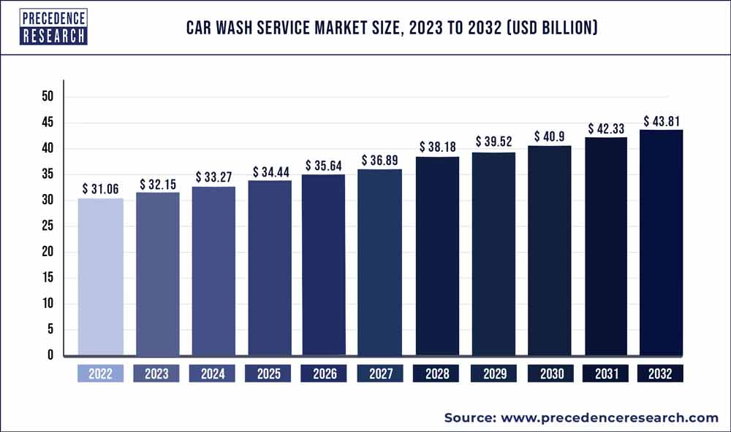
Market Survey and Groups of Interest
Established market in the USA and Canda with an emphasis on reducing cleaning times. With an estimated market size of US 15.21 Billion in 2022. North America is the Largest market.
Main Suppliers of Hardware:
Sonny’s
MacNiel Wash Systems
Belanger
Tommy’s Car Wash
Australia’s market growth is limited by water restrictions and drought. Market size is US $930 Million by 2030.
Main Suppliers of Hardware:
PDQ Manufacturing
MHCW AVW Equipment
WashTec
Motor City Wash Works
Notes:
Main car wash markets in EU: Germany, UK, France.
EU = US $2.79 B in 2021 and is expected to increase by
US is the largest market on earth at 15.21 B with 5.7% growth
Aus is small, 555.9M US in 2022. Expected to reach $930M US by 2030. with estimated growth of 4.8% during that time

Slide 9
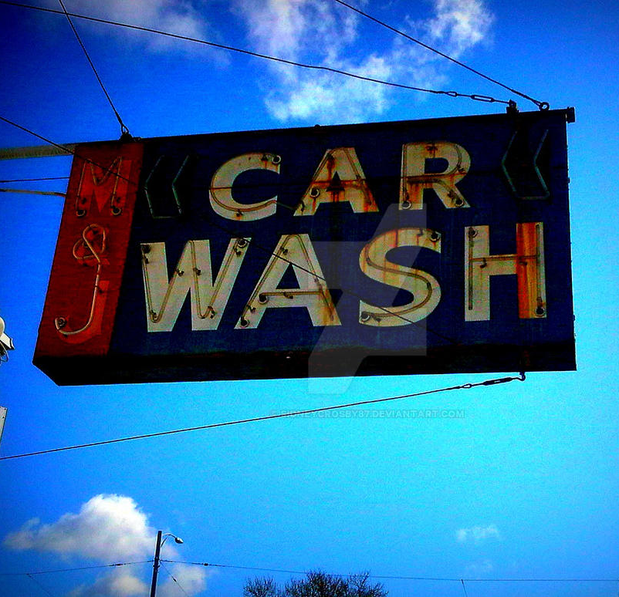
Challenges
Water Restrictions and regular drought seasons
Recycling water
Minimising water used
Ecological impact of detergent
Biodegradable detergent
Wastewater and runoff management
Maintenance
IoT and smart sensors
Serviceability oriented design
This Photo by Unknown Author is licensed under CC BY-ND
Notes:
Australia has frequent droughts, limiting the adoption of car washes. It's important that car washes be efficient enough, recycling water and limiting detergent use.
Another issue with contact-based car washes is they can potentially damage parts like mirrors, and chip paint
Maintenance is important to avoid this

Slide 10
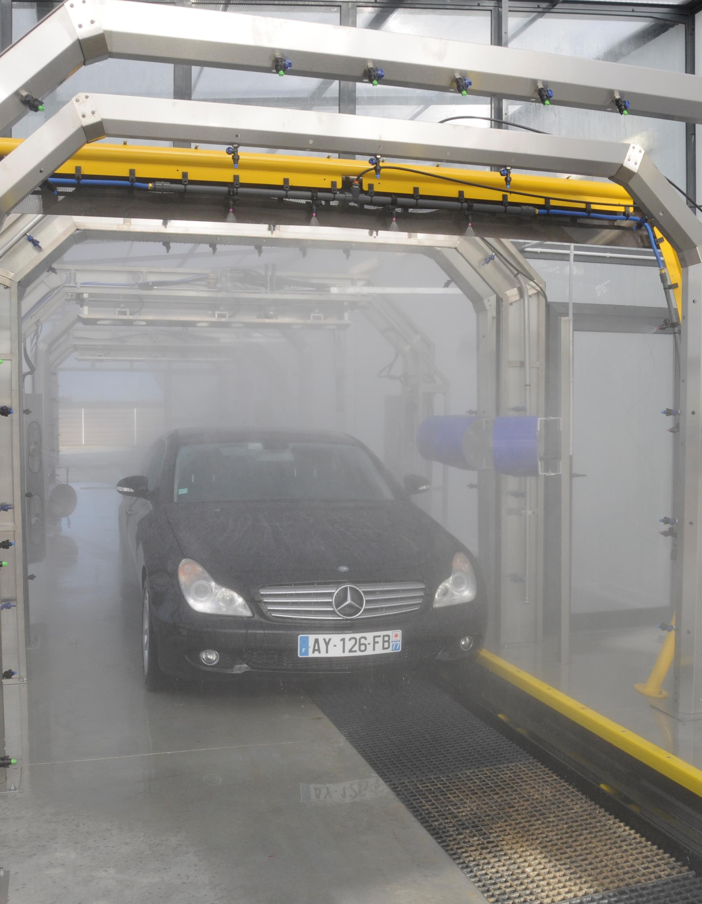
Future Developments
AI computer vision
Analysis of size and shape of car
More efficient use of water and detergent
Eco-Friendly
Water recycling systems to further reduce waste
Solar panels to offset power consumption
Biodegradable detergent
Tunnel Car Wash System
Higher throughput
Faster more efficient
Takes more space

Slide 11
Q/A

Slide 12
References
[1] https://www.electricsolenoidvalves.com/blog/valve-industry-spotlight-automatic-car-wash-systems/
[2] https://www.precisionreports.co/2022-2029-global-car-wash-professional-market-20269078
[3] https://www.linkedin.com/pulse/car-wash-market-share-forecast-2030-business-report-research
[4] https://www.industrialshields.com/case-study-automatic-car-wash-with-arduino-plc-based
[5] https://roboticsandautomationnews.com/2023/06/20/__trashed-6/69190/
[6] https://learn.automationcommunity.com/plc-automatic-car-washing-system-project/
[7] https://www.globenewswire.com/news-release/2023/09/13/2742917/0/en/Published-Market-Report-Australia-Car-Wash-Service-Market-Size-Share-Growth-2023-2030.html
[8] https://www.grandviewresearch.com/industry-analysis/us-car-wash-services-market

